Slide 1

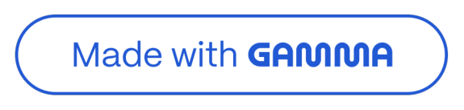
Stack in Data Structures
A beginner-friendly guide to one of the most fundamental concepts in Computer Science
BY REVA DASS

Slide 2

What is a Stack?
A Stack is a linear data structure that stores elements in a specific order 4 just like a stack of plates! You can only add or remove a plate from the top. You cannot access items from the middle or bottom directly.
Æ Linear Structure
Elements are arranged one on top of another
__ Top Access Only
Only the topmost element is accessible at any time
Ø Real-Life Analogy
Think of books stacked in a pile 4 last placed, first picked

Slide 3
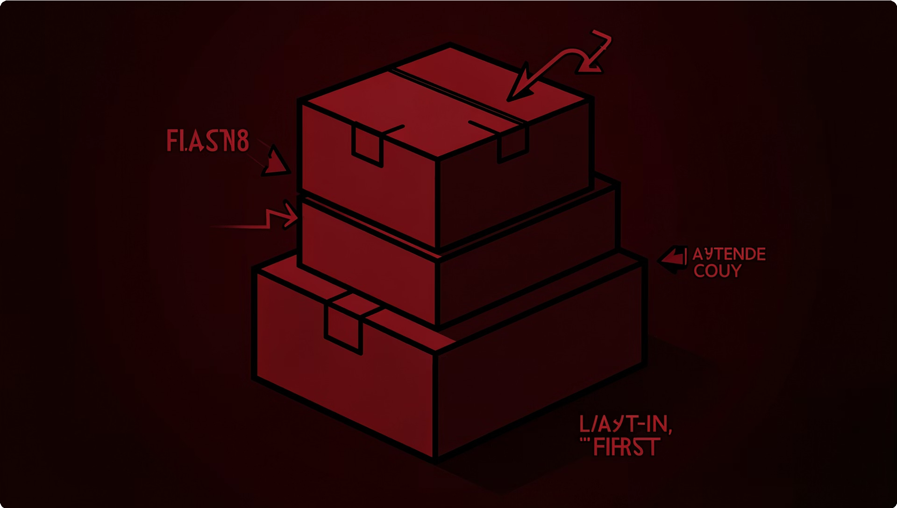

How Does a Stack Work?
LIFO PRINCIPLE
Last In, First Out 4 LIFO
The core rule of a Stack is LIFO 4 Last In, First Out. The element added most recently is the first one to be removed.
Think of a stack of books: the book you place last on top is always the first one you pick up!
This predictable order makes stacks incredibly useful in computing 4 from memory management to tracking browser history.

Slide 4

Stack Operation: Push
Push means adding a new element to the top of the stack. It is the only way to insert data into a stack.
01 02
Check if Stack is Full
If the stack has reached its maximum capacity, a Stack Overflow error occurs
Increment the Top Pointer
The top pointer moves up by one position to the next empty slot
03
Insert the Element
The new element is placed at the updated top position

Slide 5

Stack Operation: Pop
Pop means removing the topmost element from the stack. Only the top element can be removed 4 you cannot skip to the middle.
01 02
Check if Stack is Empty
If there are no elements, a Stack Underflow error is raised 4 nothing to remove!
Read the Top Element
The element at the top position is retrieved and returned to the user
03
Decrement the Top Pointer
The top pointer moves down by one, effectively removing the element

Slide 6

Other Useful Stack Operations
Peek (or Top)
Returns the topmost element without removing it. Like peeking at the top book without picking it up. Useful when you just want to look, not modify.
w IsEmpty
Checks whether the stack has any elements. Returns True if empty, False if it contains items. Essential before calling Pop to avoid errors.
w Size
Returns the total number of elements currently in the stack 4 helpful for tracking stack usage.

Slide 7
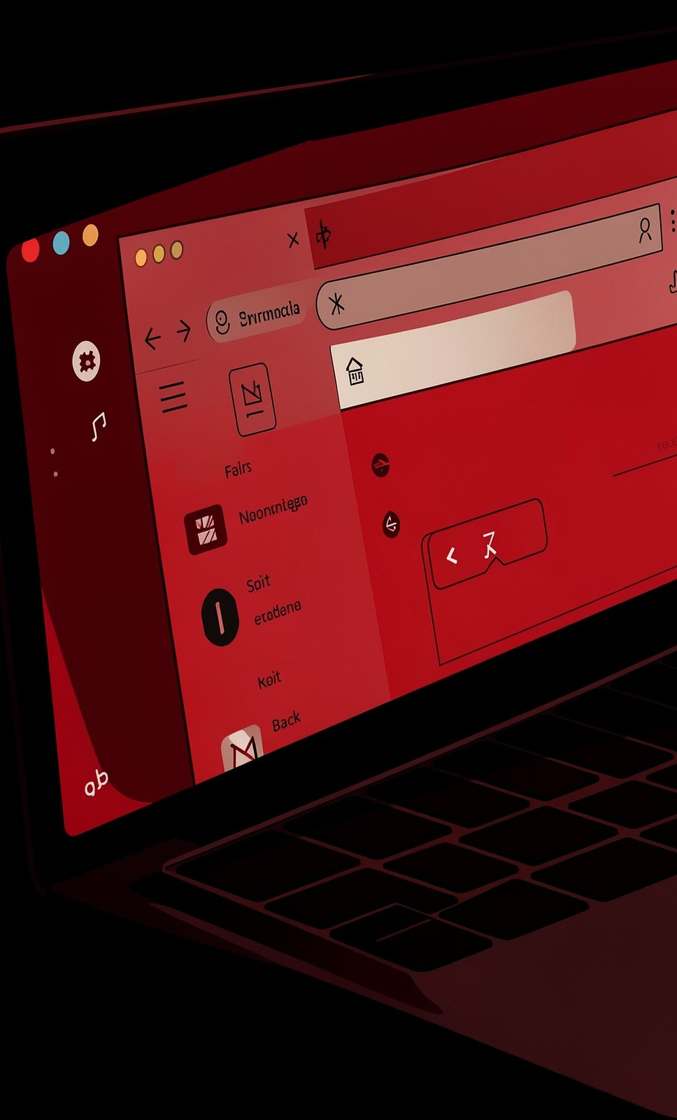
Application: Browser History
Every time you visit a webpage, it is pushed onto a stack. When you click the Back button, the current page is popped off and you return to the previous one 4 classic LIFO in action!
Visit Page A
Pushed onto stack
1
Visit Page B
Pushed on top of A
2
Press Back
Page B is popped off
3
Land on Page A
Previous page restored
4

Slide 8

Application: Undo / Redo
Text editors like MS Word or VS Code use two stacks 4 one for Undo and one for Redo 4 to track your editing history.
/ Undo Stack
Every action (type, delete, format) is pushed here. Pressing
Ctrl+Z pops the last action and reverses it.
Redo Stack
Undone actions are pushed onto the Redo stack. Pressing
Ctrl+Y re-applies them in order.

Slide 9
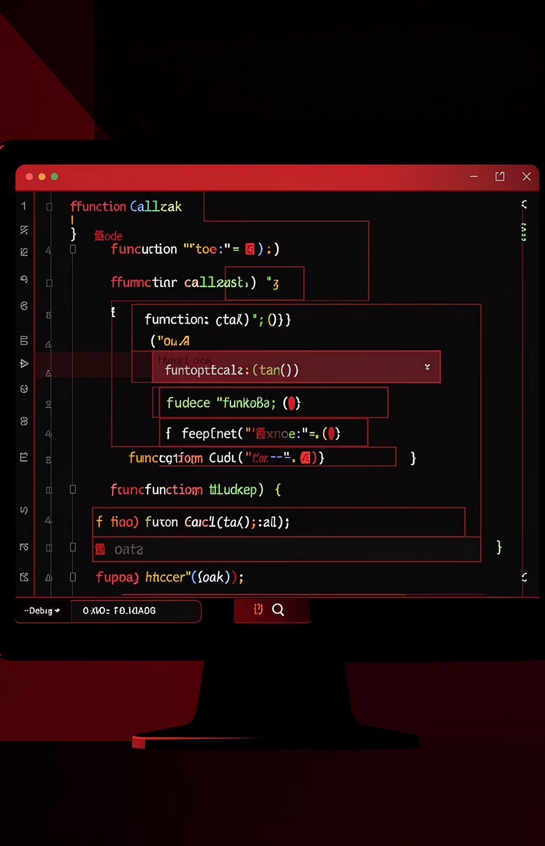

Application: Function Calls
When a program runs, the computer uses a Call Stack to manage function execution. Each time a function is called, it is pushed; when it finishes, it is popped 4 ensuring the program always returns to the right place.
Called (Push)
Executes
Returns (Pop)
This is why infinite recursion causes a "Stack Overflow" 4 the call stack runs out of space!

Slide 10



Summary: Stacks Made Easy!
What is a Stack?
A linear structure following LIFO 4 Last In, First Out
Push & Pop
Core operations to add and remove elements from the top
Peek & IsEmpty
Helper operations to inspect or check the stack safely
Applications
Browser history, Undo/Redo, and Function Call Stacks
Stacks are simple yet powerful 4 mastering them is a key step in your Data Structures journey! ;;,?

